Slide 1
Chapter 12:
Exception Handling

Slide 2
Objectives
Learn about exceptions
Try code and catch exceptions
Throw and catch multiple exceptions
Use the finally block
Understand the advantages of exception handling
Java Programming, Eighth Edition

Slide 3
Objectives (cont’d.)
Specify the exceptions that a method can throw
Trace exceptions through the call stack
Create your own Exception classes
Use an assertion
Learn how to display a virtual keyboard
Java Programming, Eighth Edition

Slide 4
Learning About Exceptions
Exceptions
  Unexpected or error conditions
  Not usual occurrences
  Causes:
    The program issues a call to a file that does not exist
    The program attempts to write to a full disk
    The user enters invalid data
    The program attempts to divide a value by 0
Java Programming, Eighth Edition

Slide 5
Learning About Exceptions (cont’d.)
Exception handling
  Object-oriented techniques used to manage Exception errors
  Runtime exceptions
Exceptions
  Objects
  Descend from the Throwable class
Java Programming, Eighth Edition

Slide 6
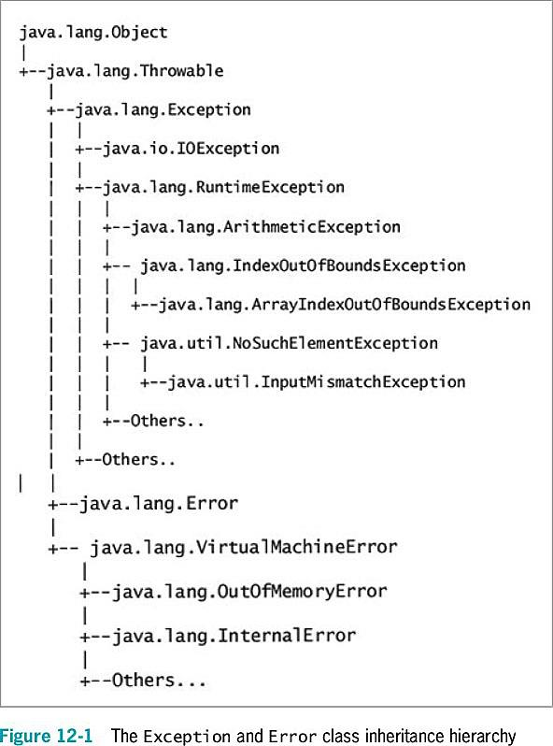
Java Programming, Eighth Edition

Slide 7
Learning About Exceptions (cont’d.)
Error class
  Represents serious errors from which a program usually cannot recover
  Error condition
    A program runs out of memory
    A program cannot locate a required class
Java Programming, Eighth Edition

Slide 8
Learning About Exceptions (cont’d.)
Exception class
  Less serious errors
  Unusual conditions
  A program can recover from this type of error
Exception class errors
  An invalid array subscript
  Performing illegal arithmetic operations
Java Programming, Eighth Edition

Slide 9
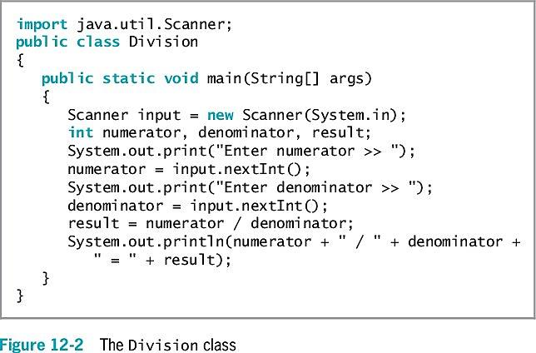
Learning About Exceptions (cont’d.)
Java Programming, Eighth Edition

Slide 10
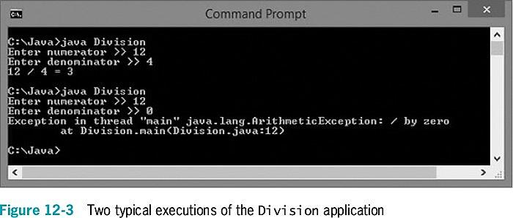
Learning About Exceptions (cont’d.)
Java Programming, Eighth Edition

Slide 11
Learning About Exceptions (cont’d.)
You do not necessarily have to deal with an exception
  Let the offending program terminate
  But doing so is abrupt and unforgiving
You can write programs without using exception-handling techniques
  Use a decision to avoid an error
Exception handling provides a more elegant solution for handling error conditions
Java Programming, Eighth Edition

Slide 12
Learning About Exceptions (cont’d.)
Fault-tolerant
  Designed to continue to operate when some part of the system fails
Robustness
  Represents the degree to which a system is resilient to stress
Java Programming, Eighth Edition

Slide 13
Trying Code and Catching Exceptions
try block
  A segment of code in which something might go wrong
  Attempts to execute
    Acknowledges an exception might occur
A try block includes:
  The keyword try
  Opening and closing curly braces
  Executable statements, which might cause an exception
Java Programming, Eighth Edition

Slide 14
Trying Code and Catching Exceptions (cont’d.)
catch block
  A segment of code
  Immediately follows a try block
  Handles an exception thrown by the try block preceding it
  Can “catch” an Object of type Exception or an Exception child class
throw statement
  Sends an Exception object out of a block or method so it can be handled elsewhere
Java Programming, Eighth Edition

Slide 15
Trying Code and Catching Exceptions (cont’d.)
A catch block includes:
  The keyword catch
  Opening and closing parentheses
    An Exception type
    A name for an instance of the Exception type
  Opening and closing curly braces
    Statements to handle the error condition
Java Programming, Eighth Edition

Slide 16
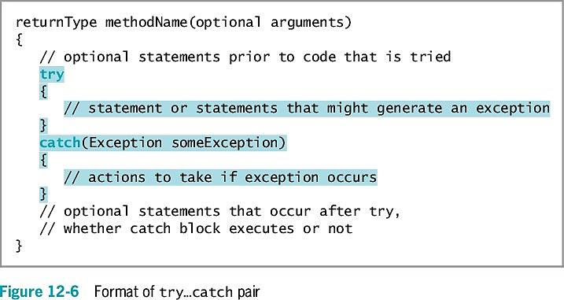
Trying Code and Catching Exceptions (cont’d.)
Java Programming, Eighth Edition

Slide 17
Trying Code and Catching Exceptions (cont’d.)
If no exception occurs within the try block, the catch block does not execute
getMessage() method
  Obtains information about the exception
Within a catch block, you might want to add code to correct the error
Java Programming, Eighth Edition

Slide 18
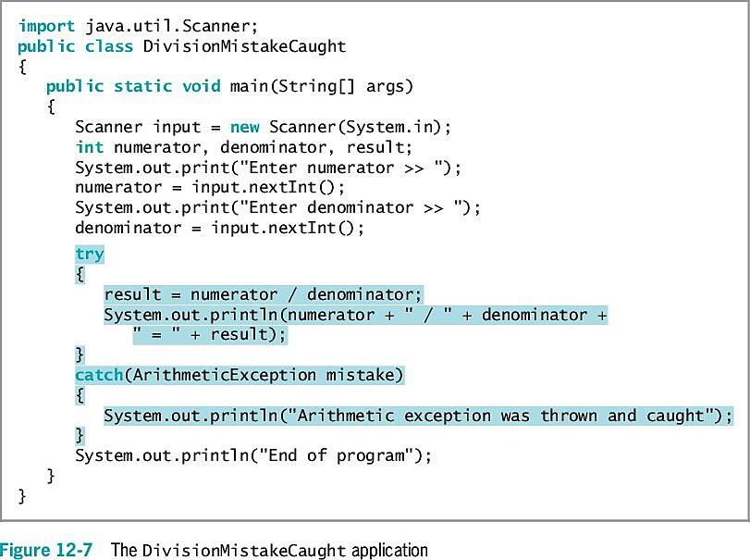
Trying Code and Catching Exceptions (cont’d.)
Java Programming, Eighth Edition

Slide 19
Using a try Block to Make Programs “Foolproof”
It is useful to circumvent data entry errors
  Handle potential data conversion exceptions caused by careless users
Using a nextLine() call will account for potential remaining characters in the input buffer
Java Programming, Eighth Edition

Slide 20
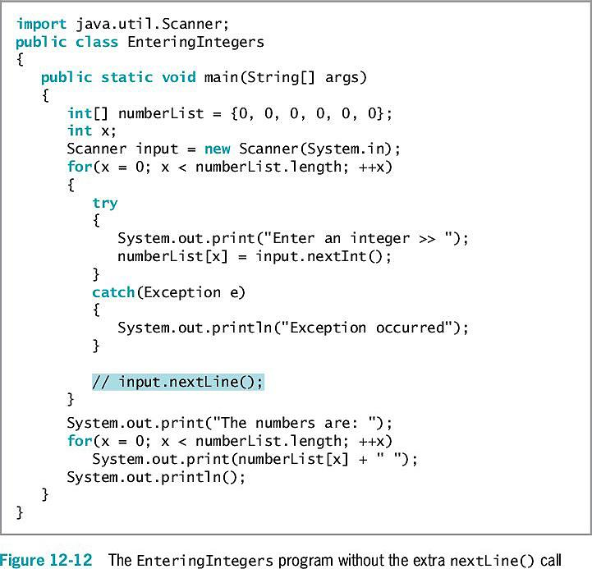
Using a try Block to Make Programs “Foolproof” (cont’d.)
Java Programming, Eighth Edition

Slide 21
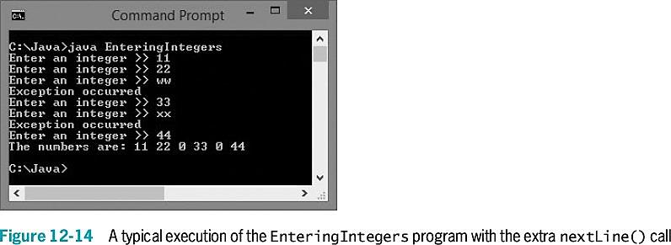
Using a try Block to Make Programs “Foolproof” (cont’d.)
Java Programming, Eighth Edition

Slide 22
Declaring and Initializing Variables in try…catch Blocks
A variable declared within a block is local to that block
  It goes out of scope when the try or catch block ends
If the conversion fails, an exception is thrown
Java Programming, Eighth Edition

Slide 23
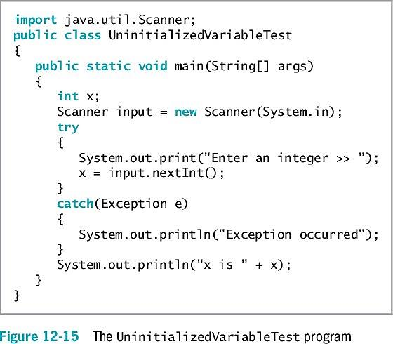
Declaring and Initializing Variables in try…catch Blocks (cont’d.)
Java Programming, Eighth Edition

Slide 24
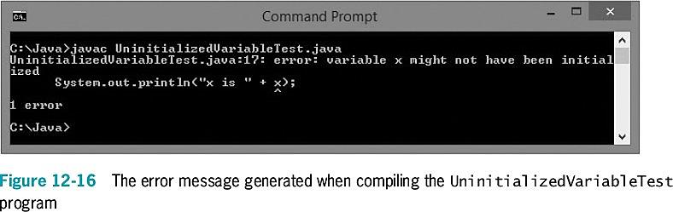
Declaring and Initializing Variables in try…catch Blocks (cont’d.)
Java Programming, Eighth Edition

Slide 25
Throwing and Catching
Multiple Exceptions
You can place multiple statements within a try block
  Only the first error-generating statement throws an exception
When a program contains multiple catch blocks:
  They are examined in sequence until a match is found for the Exception type
  The matching catch block executes
  Each remaining catch block is bypassed
Java Programming, Eighth Edition

Slide 26
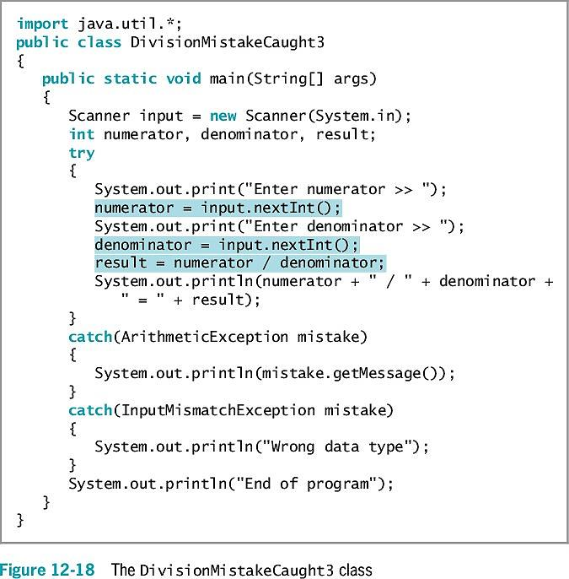
Java Programming, Eighth Edition

Slide 27
Throwing and Catching
Multiple Exceptions (cont’d.)
“Catch-all” block
  Accepts a more generic Exception argument type:
  catch(Exception e)
Unreachable code
  Program statements that can never execute under any circumstances
In Java 7 and 8, a catch block can also be written to catch multiple Exception types
It is poor style for a method to throw more than three or four Exception types
Java Programming, Eighth Edition

Slide 28
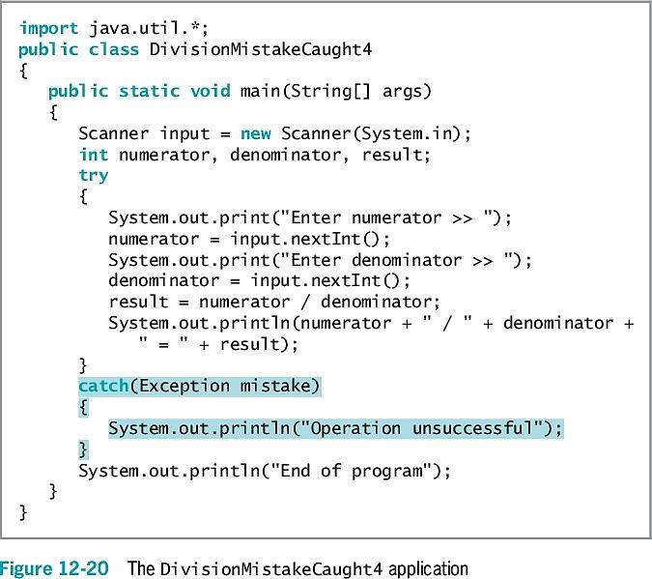
Java Programming, Eighth Edition

Slide 29
Using the finally Block
finally block
  Use for actions you must perform at the end of a try…catch sequence
  Use to perform cleanup tasks
  Executes regardless of whether the preceding try block identifies an exception
Java Programming, Eighth Edition

Slide 30
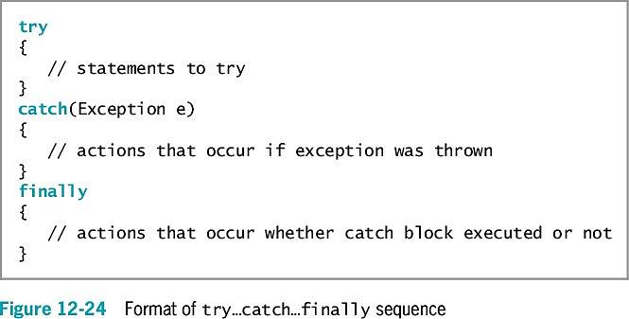
Using the finally Block (cont’d.)
Java Programming, Eighth Edition

Slide 31
Using the finally Block (cont’d.)
When the try code fails:
  It throws an exception
  The Exception object is caught
  The catch block executes
    Control passes to statements at the end of the method
Java Programming, Eighth Edition

Slide 32
Using the finally Block (cont’d.)
Reasons the final set of statements might never execute:
  An unplanned exception might occur
  The try or catch block might contain a System.exit(); statement
The try block might throw an Exception object for which you did not provide a catch block
  Program execution stops immediately
  The exception is sent to the operating system for handling
  The current method is abandoned
Java Programming, Eighth Edition

Slide 33
Using the finally Block (cont’d.)
When the finally block is used, finally statements execute before the method is abandoned
The finally block executes no matter what outcome of the try block occurs
  The try ends normally
  The catch executes
  The exception causes the method to abandon prematurely
Java Programming, Eighth Edition

Slide 34
Understanding the Advantages of Exception Handling
Before object-oriented programming languages, errors were handled with confusing, error-prone methods
  When any method fails, the program sets appropriate error code
  Difficult to follow
    The application’s purpose and intended outcome are lost in a maze of if statements
    Coding mistakes are made because of complicated nesting
Java Programming, Eighth Edition

Slide 35
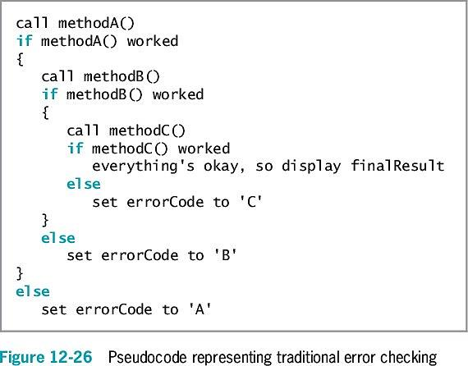
Understanding the Advantages of Exception Handling (cont’d.)
Java Programming, Eighth Edition

Slide 36
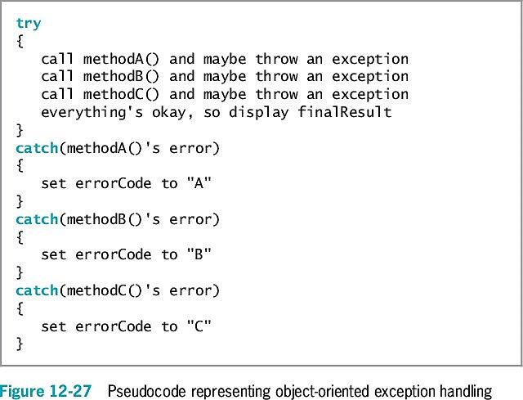
Understanding the Advantages of Exception Handling (cont’d.)
Java Programming, Seventh Edition
Java Programming, Eighth Edition

Slide 37
Understanding the Advantages of Exception Handling (cont’d.)
Java’s object-oriented, error-handling technique
  Statements of the program that do the “real” work are placed together, where their logic is easy to follow
  Unusual, exceptional events are grouped and moved out of the way
An advantage to object-oriented exception handling is flexibility in handling of error situations
Appropriately deal with exceptions as you decide how to handle them
Java Programming, Eighth Edition

Slide 38
Specifying the Exceptions
That a Method Can Throw
If a method throws an exception that it will not catch but will be caught by a different method, use the keyword throws followed by the Exception type in the method header
Exception specification
  Lists exceptions that a method may throw
Every Java method has the potential to throw an exception
  For most Java methods, do not use the throws clause
  Let Java handle any exception by shutting down the program
  Most exceptions never have to be explicitly thrown or caught
Java Programming, Eighth Edition

Slide 39
Specifying the Exceptions
That a Method Can Throw (cont’d.)
Unchecked exceptions
  Inherit from the Error class or the RuntimeException class
  You are not required to handle these exceptions
    You can simply let the program terminate
    An example is dividing by zero
Checked exceptions
  Programmers should anticipate checked exceptions
  Programs should be able to recover from them
Java Programming, Eighth Edition

Slide 40
Specifying the Exceptions
That a Method Can Throw (cont’d.)
If you throw a checked exception from a method, you must do one of the following:
  Catch it
  Declare the exception in the method header’s throws clause
To use a method to its full potential, you must know:
  Method’s name
  Method’s return type
  Type and number of arguments the method requires
  Type and number of exceptions the method throws
Java Programming, Eighth Edition

Slide 41
Tracing Exceptions Through the Call Stack
Call stack
  The memory location where the computer stores the list of method locations to which the system must return
When a method throws an exception:
  The exception is thrown to the next method up the call stack
  Methods are allowed to handle exceptions wherever the programmer has decided it is most appropriate
    Including allowing the operating system to handle the error
Java Programming, Eighth Edition

Slide 42
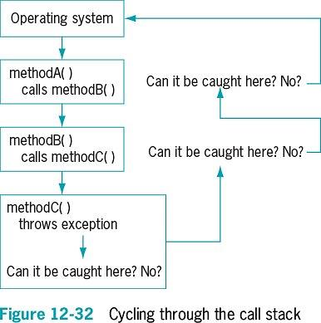
Tracing Exceptions Through the Call Stack (cont’d.)
Java Programming, Eighth Edition

Slide 43
Tracing Exceptions Through the Call Stack (cont’d.)
printStackTrace() method
  Displays a list of methods in the call stack
  Determines the location of an exception
  Is not placed in a finished program
    Most useful for diagnosing problems
Java Programming, Eighth Edition

Slide 44
Creating Your Own Exception Classes
Java provides over 40 categories of Exceptions
Java allows you to create your own Exception classes
  Extend a subclass of Throwable
Exception class constructors:
  Exception()
  Exception(String message)
  Exception(String message, Throwable cause)
  Exception(Throwable cause)
Java Programming, Eighth Edition

Slide 45
Using Assertions
Assertion
  A Java language feature
  Detects logic errors
  Debugs programs
assert statement
  Creates an assertion, such as:
  assert booleanExpression : optionalErrorMessage
  The Boolean expression in the assert statement should always be true if the program is working correctly
Java Programming, Eighth Edition

Slide 46
Using Assertions (cont’d.)
An AssertionError is thrown when a condition is false
To enable an assertion, you must use the -ea option when executing a program
Java Programming, Eighth Edition

Slide 47
Displaying the Virtual Keyboard
A virtual keyboard is a computer keyboard that appears on the screen
Allows user to point to and click keys with a mouse
  With a touch screen user can touch keys with finger or stylus
Java Programming, Eighth Edition

Slide 48
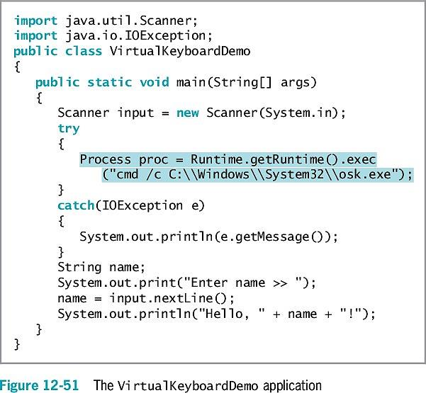
Java Programming, Eighth Edition

Slide 49
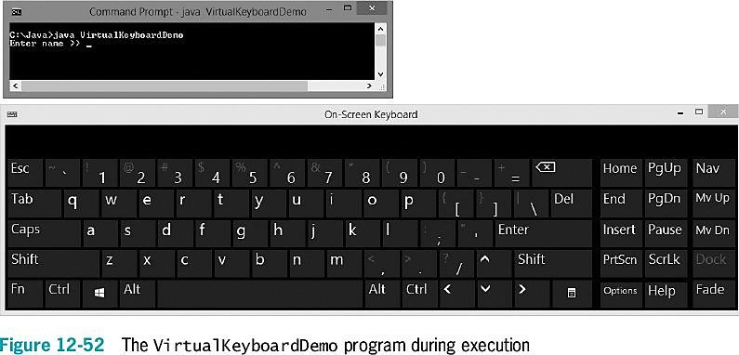
Java Programming, Eighth Edition

Slide 50
You Do It
Throwing and Catching an Exception
Using Multiple catch Blocks
Creating a Class That Automatically Throws Exceptions
  Creating a Class That Passes on an Exception Object
  Creating an Application That Can Catch Exceptions
  Extending a Class That Throws Exceptions
  Creating an Exception Class
  Using an Exception You Created
Displaying the Windows Calculator
Java Programming, Eighth Edition

Slide 51
Don’t Do It
Don’t forget that all the statements in a try block might not execute
Don’t forget you might need a nextLine() method call after an attempt to read numeric data from the keyboard throws an exception
Don’t forget that a variable declared in a try block goes out of scope at the end of the block
Don’t forget that when a variables get its usable value within a try block, you must ensure that it has a valid value before attempting to use it
Java Programming, Eighth Edition

Slide 52
Don’t Do It (cont’d.)
Don’t forget to place more specific catch blocks before more general ones
Don’t forget to write a throws clause for a method that throws an exception but does not handle it
Don’t forget to handle any checked exception thrown to your method
Java Programming, Eighth Edition

Slide 53
Summary
Exception
  An unexpected or error condition
Exception handling
  Object-oriented techniques to manage errors
Basic classes of errors: Error and Exception
Exception-handling code
  try block
  catch block
  finally block
Java Programming, Eighth Edition

Slide 54
Summary (cont’d.)
Use the throws <name>Exception clause after the method header
  Indicate the type of exception that might be thrown
Call stack
  A list of method locations to which the system must return
Java provides over 40 categories of Exceptions
  Create your own Exception classes
Assertion
  State a condition that should be true
  Java throws an AssertionError when it is not
Java Programming, Eighth Edition

